Slide 1
DICOM
Digital
Imaging
Communications
Medicine
醫療數位影像傳輸協定
Digital Imaging and Communications in Medicine

Slide 2


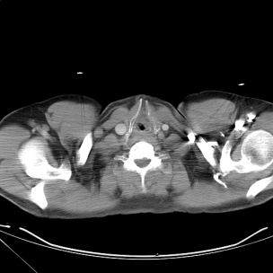
DICOM
Patient’s information
病人看診資料
影像
CT_00001.dcm

Slide 3

data element
CT_00001. dcm
CT_00001.xml
Tag
VRType
Value Length
Value Field
DICOM
Data Element :
Tag | VRType | Length | Value Field
Size:
4 bytes | 2 bytes | 2 bytes | Length bytes

Slide 4
Tag
Data Element :
Tag | VRType | Length | Value Field
Size:
4 bytes | 2 bytes | 2 bytes | Length bytes
Group number | Element number
2 bytes | 2 bytes
Example:
0x0010 0x0010
Table:
Group number | Element number | Field Name
0010 | 0010 | Patient's Name
0010 | 0020 | Patient ID
0010 | 0030 | Patient's Birth Date
0010 | 0040 | Patient's Sex
0010 | 1010 | Patient's Age

Slide 5
VRType
Data Element :
Tag | VRType | Length | Value Field
Size:
4 bytes | 2 bytes | 2 bytes | Length bytes
0010 0010
Value Representation
2 bytes
Example 1:
P N
Example 2:
T M
Table:
Value Representation | Description
OF | Other Float | *
PN | Person Name
SQ | Sequence of items | *
TM | Time
DA | Date

Slide 6
*VRType
Data Element :
Tag | VRType | Length | Value Field
Size:
4 bytes | 4 bytes | 4 bytes | Length bytes
Value Representation | Reserved space
2 bytes | 2 bytes
Example :
S Q
Table:
Value Representation | Description
OF | Other Float | *
PN | Person Name
SQ | Sequence of items | *
TM | Time
DA | Date

Slide 7
Length
Data Element :
Tag | VRType | Length | Value Field
Size:
4 bytes | 2 bytes | 2 bytes | Length bytes
0010 0010
P N
Value Length | Range
2 bytes | -36768~36767
Example :
24

Slide 8
Value Field
Data Element :
Tag | VRType | Length | Value Field
Size:
4 bytes | 2 bytes | 2 bytes | Length bytes
0010 0010
P N
24
Value
24 bytes
Example1 :
Sample^Diagnostic^Fusion
Example2 :
禮品皓

Slide 9
reference
DICOM Format:
DICOM的数据结构和编码(1)
Tag & Field Name:
DICOM Attributes
VRType :
DICOM Tag 資料型態說明
Value Representations

Slide 10
DICOM File
Petient’s data
Image data
Data element(資料元素)
Tag(標籤)
VRType(型別)
Value Length(長度)
Value Field(內容)
End Thank you for your attention

